Slide 1


An Overview
Notes:
-Quick overview: Clicklaw is essentially a database of legal resources and services for the everyday person. It’s a way to find answers to everyday legal problems, but specifically for people in B.C. It’s a good starting point if you’re trying to find out what a legal issue is, or to find a person that can help.

Slide 2




Courthouse Libraries BC provides 4 Programs that help the public:
A website that aggregates plain language legal information and services for British Columbians
Collaboratively developed, plain language legal publications that are published online in a familiar Wiki format
Helps public libraries provide current legal information
A library with 29 branches to help clients find and use legal information
Notes:
Clicklaw is just one piece of the resources that CLBC provides for the public. We’ll go through these in more detail, but just to give you an overview…

Slide 3




























Notes:
-Clicklaw itself isn’t a publisher of content. You’ll search for something—like adoption, for example—then get a search result of resources and services that relate to the topic, but they’ll be published by a contributor organization. There are dozens of different organizations in BC that add their resources to Clicklaw.
-These are some examples.

Slide 4
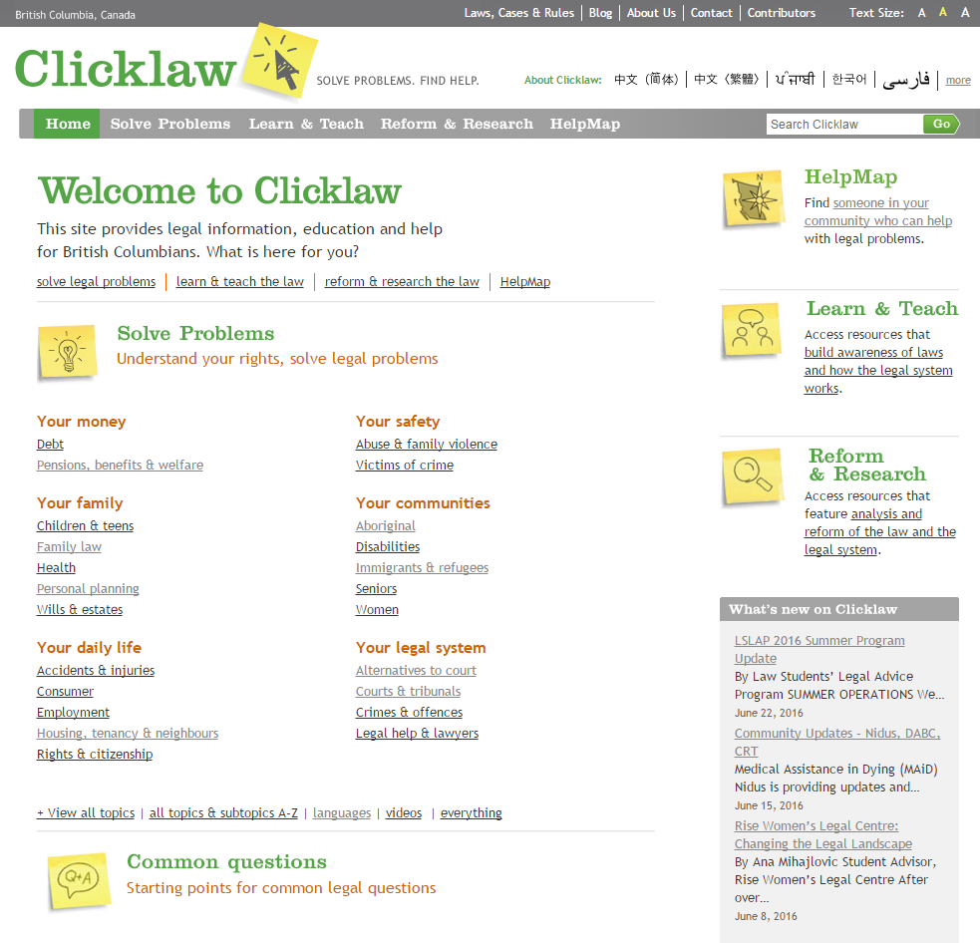
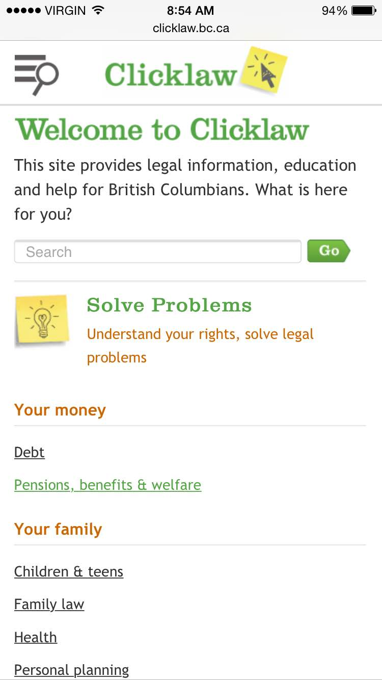
Mobile view
www.clicklaw.bc.ca
Notes:
-You can view the website on your computer, or mobile phone – anywhere, anytime.
-You can search for legal information in five ways:
Keyword search in the search bar on the right
Click on topics to find resources and services
Using the Common Questions
By language
By location
The Clicklaw taxonomy/terminology is developed collaboratively by contributors. It’s language that the public would use to describe their legal issue, rather than legal terminology that a lawyer would use.

Slide 5
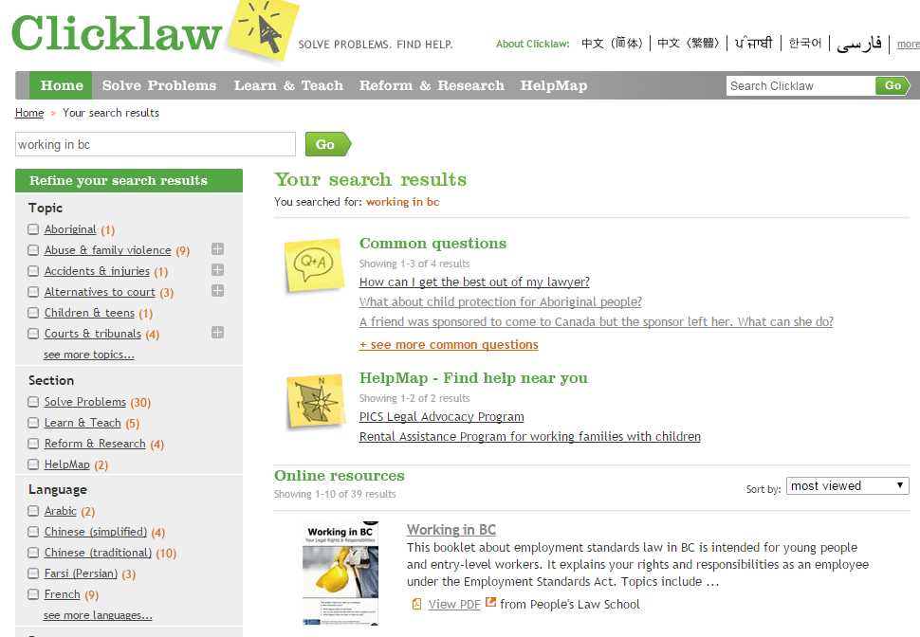
Notes:
-You’ll see Common Questions. These FAQs are added to as Courthouse Libraries BC frontline staff get asked questions repeatedly about a particular topic. All questions are written in easy to understand, plain language and direct people to good starting places. These have been narrowed down to those that relate to “working in bc” – what was entered into the search bar. Let Audrey know if you have any suggestions. (Contact info at end of slide)
-You’ll also see HelpMap Services. These are clinics, phone lines, and other services where your client can talk to a real live person about their issue. You can search the HelpMap on it’s own, but because we’ve searched for working in bc, you’ll see only results that relate to that.
-Last but not least, there is a new feature that lets you sort resource results by last reviewed date. You can see it in the drop down, along with methods to sort results by most viewed, relevance, and alphabetical order.

Slide 6

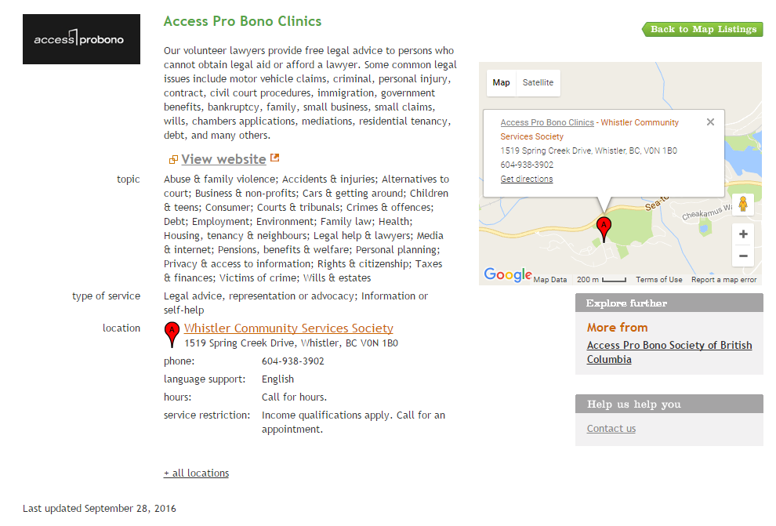
Notes:
-Here’s an example of a service listing you can find on the Clicklaw HelpMap. Access Pro Bono has clinics all over the province where volunteer lawyers provide free legal advice to persons who can’t get legal advice or afford a lawyer.

Slide 7
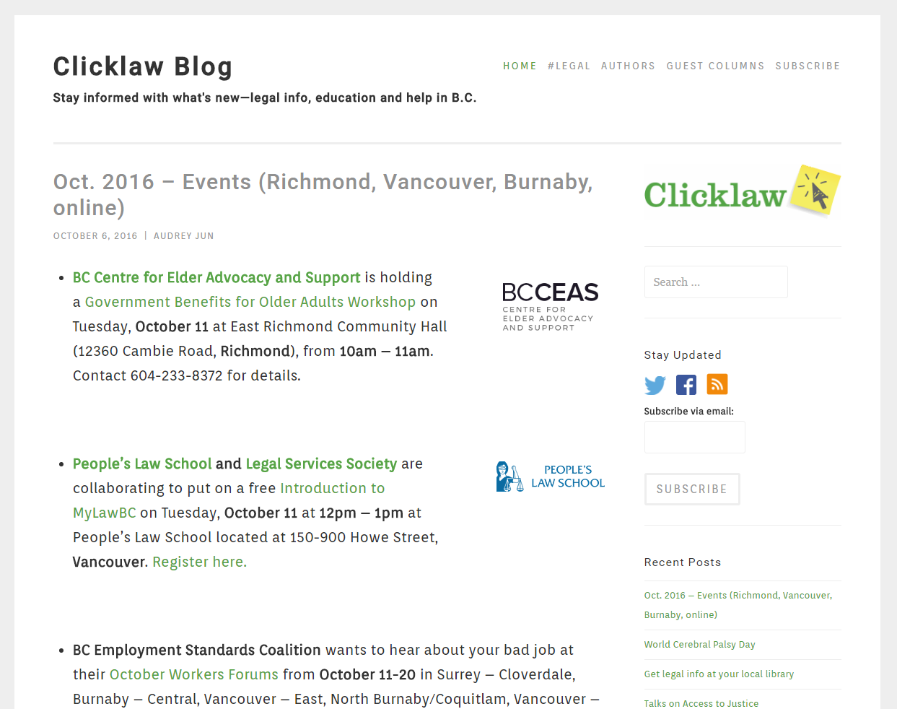
blog.clicklaw.bc.ca
Notes:
-How do you stay updated with legal info when there’s so much new and updated info all the time? Everyone relies on word of mouth. One great and easy way is to sign up for the Clicklaw blog mailing list.
-The blog is growing and subscribed to by legal intermediaries around the province as well as journalists.
-If you subscribe with email, you will get notified about events around the province, webinar and in-person training opportunities, new resources and services, and more!

Slide 8
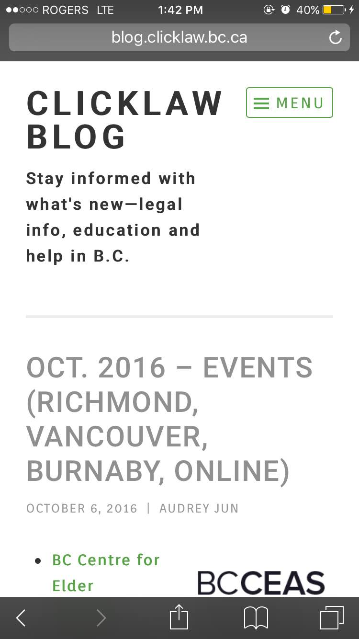
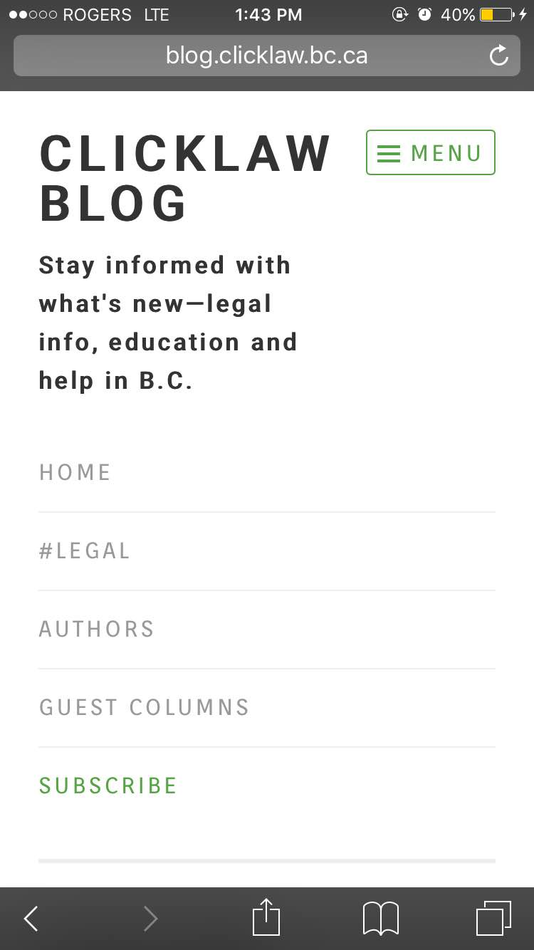
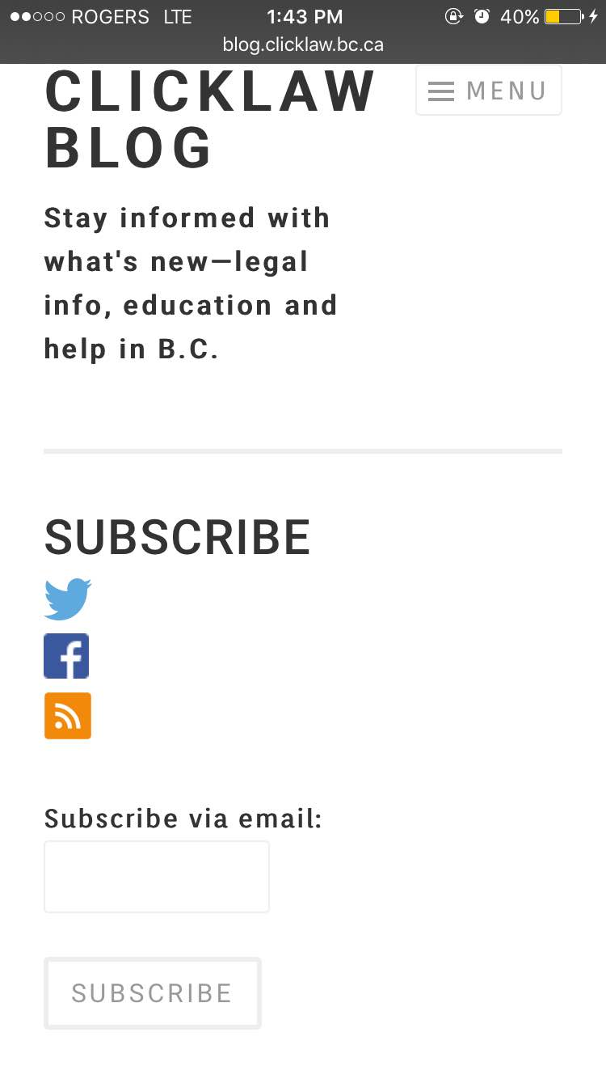
blog.clicklaw.bc.ca
blog.clicklaw.bc.ca
Notes:
-You can subscribe on your mobile phone right now.
1) Click on the Menu Icon on the top right
2) Click Subscribe.
3) Enter your email and hit Subscribe.
-Clicklaw is also on Facebook and Twitter as @Clicklaw, so if you’re active on either platform, please follow and like away!

Slide 9

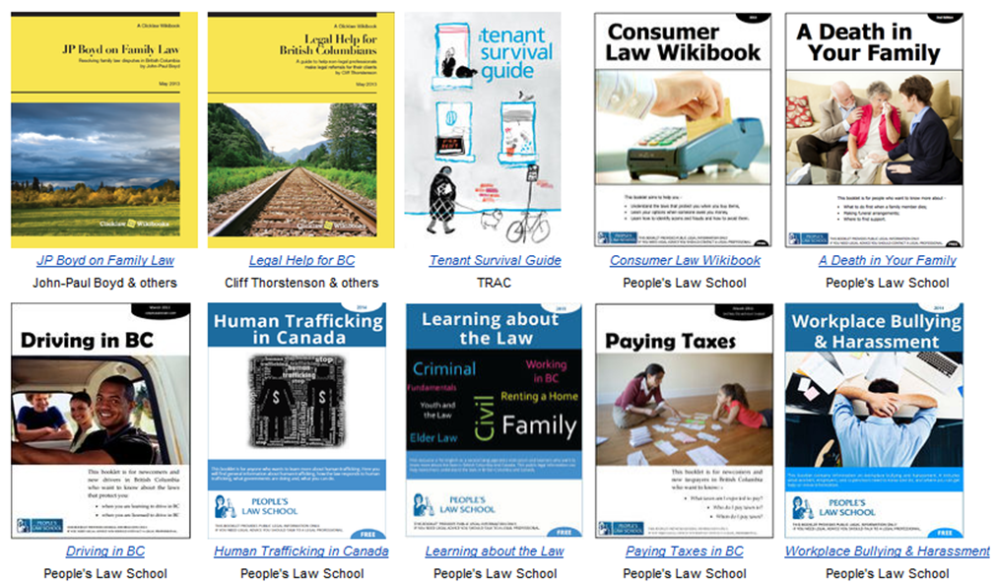
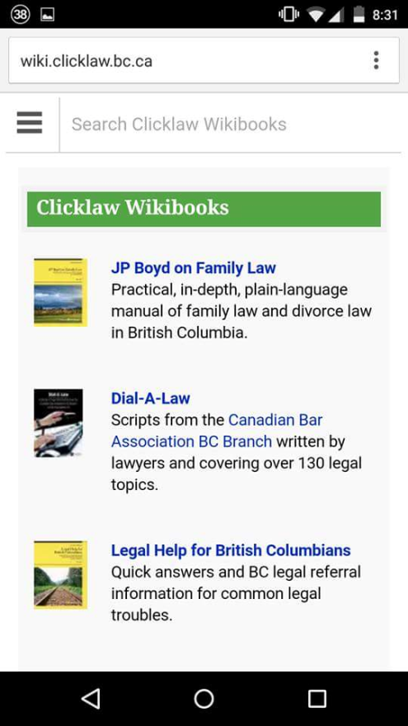

Mobile view
wiki.clicklaw.bc.ca
Notes:
-If you’re dealing with a family law issue, workplace bullying and harassment or more, don’t forget to check out the Clicklaw Wikibooks (you can get to them through the footer on the Clicklaw website).
-To explain the Wikibooks…If Clicklaw is like Google + the law in BC, the Clicklaw Wikibooks is the wikipedia counterpart. It has some “wikibooks” or groupings of wiki pages by topic.

Slide 10
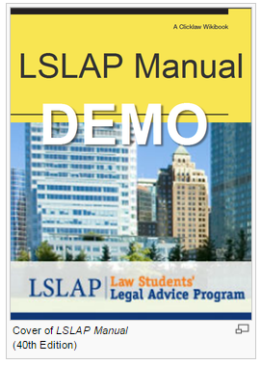
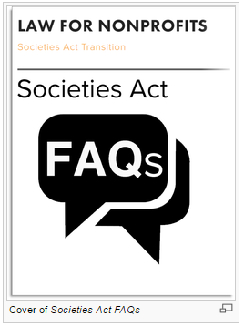
Coming soon!
Notes:
-New and Coming soon to the Wikibooks – all of the UBC LSLAP Manuals are being ported over to the wikibooks – having only been previously available in PDF format, they will be more easily readable and searchable on the wikibooks. Includes 22 chapters on all different areas of law, including family law, victims, worker’s compensation, creditors and debtors, mental health law, and more.
-Also coming soon are some Societies Act Transition FAQs. Starting November 28 of this year, over 27,000 non-profit societies in BC must transition to the new Societies Act in the next two years. The Law for Non Profits organization has prepared a set of handy FAQs to help no profits understand the requirements.
-How to hear about when these new titles launch? Subscribe to the Clicklaw blog!

Slide 11

Contact Audrey with Questions
Audrey Jun
Clicklaw Program Coordinator,
Courthouse Libraries BC
ajun@courthouselibrary.ca
Twitter: @audreyyjun

