Slide 1


An Overview

Slide 2





Collaboratively developed, plain language legal publications that are published online in a familiar Wiki format.
Operated by Courthouse Libraries BC in partnership with organizations such as:
Content can only be updated by pre-approved lawyers and PLEI organizations that volunteer as editors
Users can view online or download and print a page, a whole title, or a custom selection
Over 20 titles and counting with approximately 500,000 users annually
British Columbia focused legal content
wiki.clicklaw.bc.ca

Slide 3
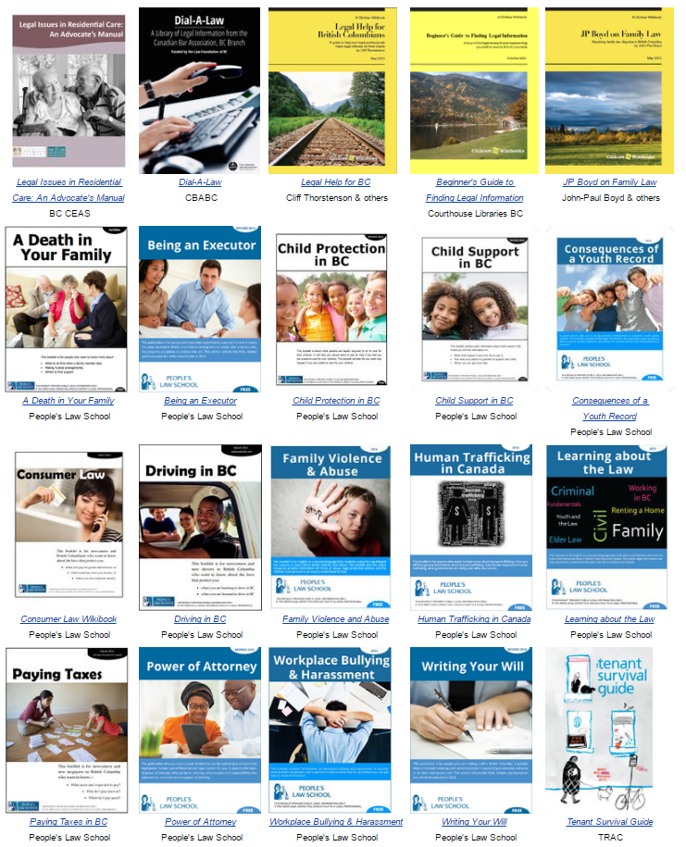
How does it work?
A growing community of participating PLEI organizations and legal professionals contribute content and help keep it accurate
While Courthouse Libraries BC manages the platform and helps recruit volunteer contributors
wiki.clicklaw.bc.ca

Slide 4
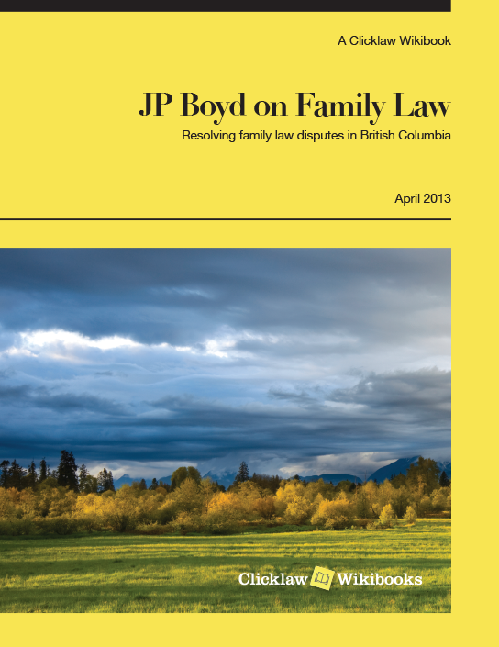
Example Clicklaw Wikibook: JP Boyd on Family Law
1,000+ pages of self-help material written by a former Vancouver family lawyer
30+ lawyers and judges contribute updates
Approximately 25,000 monthly users in 2016
Print version published and distributed to public libraries in BC (& available via print-on-demand)
wiki.clicklaw.bc.ca

Slide 5
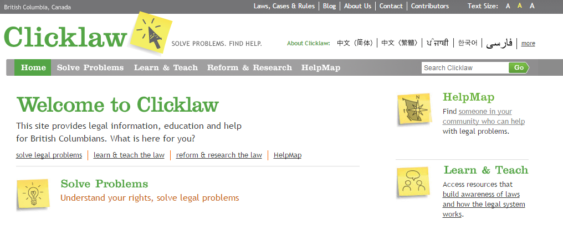
Three good reasons to use Clicklaw Wikibooks
1. As a handy referral for non-clients
Many visitors to Clicklaw Wikibooks are referred there by legal professionals
For self represented parties adverse in interest:
  Clicklaw Wikibooks is a helpful, neutral source with plain language info
Even where there’s no ethical conflict:
Clients sometimes ask questions outside your area of practice
Not all inquiries are economical or appropriate for full retainer
Know where to send people for help!
A related website www.clicklaw.bc.ca is also a good place to refer the public…
wiki.clicklaw.bc.ca

Slide 6
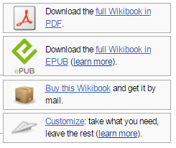
Three good reasons to use Clicklaw Wikibooks
2. To help prepare your clients
Use Clicklaw Wikibooks to “translate” rules and procedures into accessible plain language, while still maintaining accuracy
Bigger picture content may help set realistic expectations for the client’s situation
Easily print or email a Wikibook page or section for your client
wiki.clicklaw.bc.ca

Slide 7
Three good reasons to use Clicklaw Wikibooks
3. As an entry point into unfamiliar areas of law
Clicklaw Wikibooks provide well-organized overviews leading to citations, relevant legislation, and reliable secondary sources
Topics covering:
  Family law
  Consumer law
  Criminal law
  Tenancy law
  Wills and estates
  Elder abuse
  Employment law
  Law for immigrants
Clearly listed dates of last legal review
wiki.clicklaw.bc.ca

Slide 8
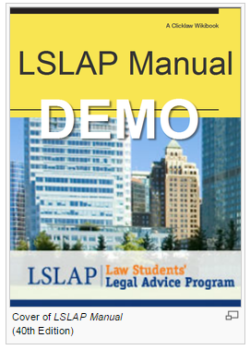
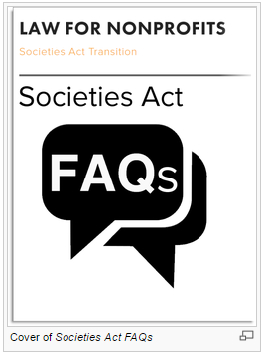
Coming soon!
Notes:
-New and Coming soon to the Wikibooks – all of the UBC LSLAP Manuals are being ported over to the wikibooks – having only been previously available in PDF format, they will be more easily readable and searchable on the wikibooks. Includes 22 chapters on all different areas of law, including family law, victims, worker’s compensation, creditors and debtors, mental health law, and more.
-Also coming soon are some Societies Act Transition FAQs. Starting November 28 of this year, over 27,000 non-profit societies in BC must transition to the new Societies Act in the next two years. The Law for Non Profits organization has prepared a set of handy FAQs to help no profits understand the requirements.
-How to hear about when these new titles launch? Subscribe to the Clicklaw blog!

Slide 9
Contact Clicklaw Wikibooks with questions
http://wiki.clicklaw.bc.ca
editor@clicklaw.bc.ca

